Slide 1
DISTRICT GRANT MANAGEMENT SEMINAR
DISTRICT 7630
March 30, 2024
Notes:
This GMS for President-elects and AG’s to give overview of district grants, possible projects, eligibility, timelines for applying and reporting.
GMS at District Conference to give more details on how to manage the grant, application and reporting process. Encourage Foundation chairs, grants chairs, other club members to attend. Friday, May 1, 9 a.m.

Slide 2
$1,000
Annual Fund
SHARE
Earnings help pay for
TRF
administration
YEAR 1
YEAR 2
YEAR 3
District Designated Fund (DDF)
S
World Fund
50% = $500
50% = $500
47.5% = $475
47.5% = $475
2.5% = $25
2.5% = $25
Share
For TRF administration

Slide 3
PURPOSE
Understand what is a District grant
Learn stewardship expectations
Designing a project
Club eligibility and qualifications to apply
Funding
Reporting process

Slide 4
DISTRICT GRANT DEFINED
District grants are used to fund smaller-scale Rotary club projects
Minimum award is $1,000
Maximum award is $5,000
Club must provide at least 20% of funding to the project. Therefore, a project must be $1,250 or larger.
Notes:
Speaking points:
District grants fund smaller projects than a global grant would do.
Minimum awarded to a project is $1,000, max $5,000
Club must provide at least 20% of the total project funding.
Project can be larger but that’s the max money you can receive from district for the project.

Slide 5
PROJECT REQUIREMENTS
Project begins and ends within the Rotary year it is funded
Multiple-club, area-wide projects, single-club projects
Only one grant per club as primary sponsor
Repeat projects by same club(s) not eligible in consecutive years
Notes:
Projects must begin and be completed in the Rotary year they are funded. Clubs may not actually begin the project until RI gives approval.
Multiple club projects will be given priority consideration over single club projects. ENCOURAGE clubs to partner on projects.
Repeat projects are not eligible the following year to the same club or clubs.

Slide 6
PROJECT REQUIREMENTS
In a Multiple-club project, the primary club is responsible for the project.
All qualifications apply to the primary club.
The primary club controls the finances and does the payments.
The primary club does the reporting.
Notes:
Projects must begin and be completed in the Rotary year they are funded. Clubs may not actually begin the project until RI gives approval.
Multiple club projects will be given priority consideration over single club projects. ENCOURAGE clubs to partner on projects.
Repeat projects are not eligible the following year to the same club or clubs.

Slide 7
DESIGNING A PROJECT

Slide 8
What makes a good project?
Want to build your club’s bank account?
Don’t apply for a district grant…
Want to give money to a nonprofit to help their administration?
Don’t apply for a district grant…
Notes:
Taking your members on a cruise for fun and fellowship does not qualify for a good reason for a district grant.
Outright giving money to non-profit organizations will not qualify either.

Slide 9

SUCCESSFUL GRANT PROJECTS
Meet community needs
Are sustainable
Involve a partner if possible
Have an implementation
plan
Maintain proper stewardship
of funds and paperwork
Notes:
Speaking points:
Beneficiaries are more likely to support and participate in a project that addresses the needs of a community and has a sustainable outcome – one that will continue after the funds have been spent.
Rotarians should partner with the community and organizations with technical expertise; however, projects must be managed by Rotarians.
Working together means more than financial participation; it also means using each partner’s expertise to implement the project or activity.
The implementation plan should include an achievable project timeline and should be shared with partners and beneficiaries.
By establishing a financial management plan before applying for grants, clubs ensure that they will have processes in place to manage funds before any money is received.

Slide 10
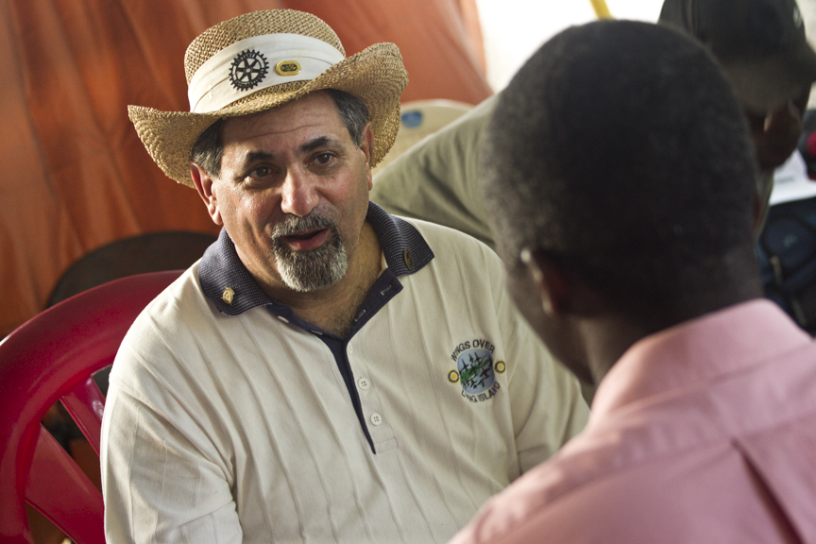
NEEDS ASSESSMENT
Base projects on
communities’
needs
Determine what
resources your
club and potential
partners have
Talk to the community
Notes:
Speaking points:
Asking members of the community what they need and what strengths they bring to the project results in greater support and involvement, which leads to a more sustainable, lasting impact.
Once the needs are identified, your club should consider which can be addressed with the resources, skills, and availability of your club and its potential partners, including other Rotary clubs, districts, The Rotary Foundation, and non-Rotary organizations.
Continue involving the community during the selection of the project and its planning and implementation.
The Rotary publications Communities in Action and Community Assessment Tools offer information and resources for conducting a community needs assessment.
Discussion questions:
Has anyone been involved in conducting a community needs assessment? What was your experience?
What successes or challenges can you share?

Slide 11
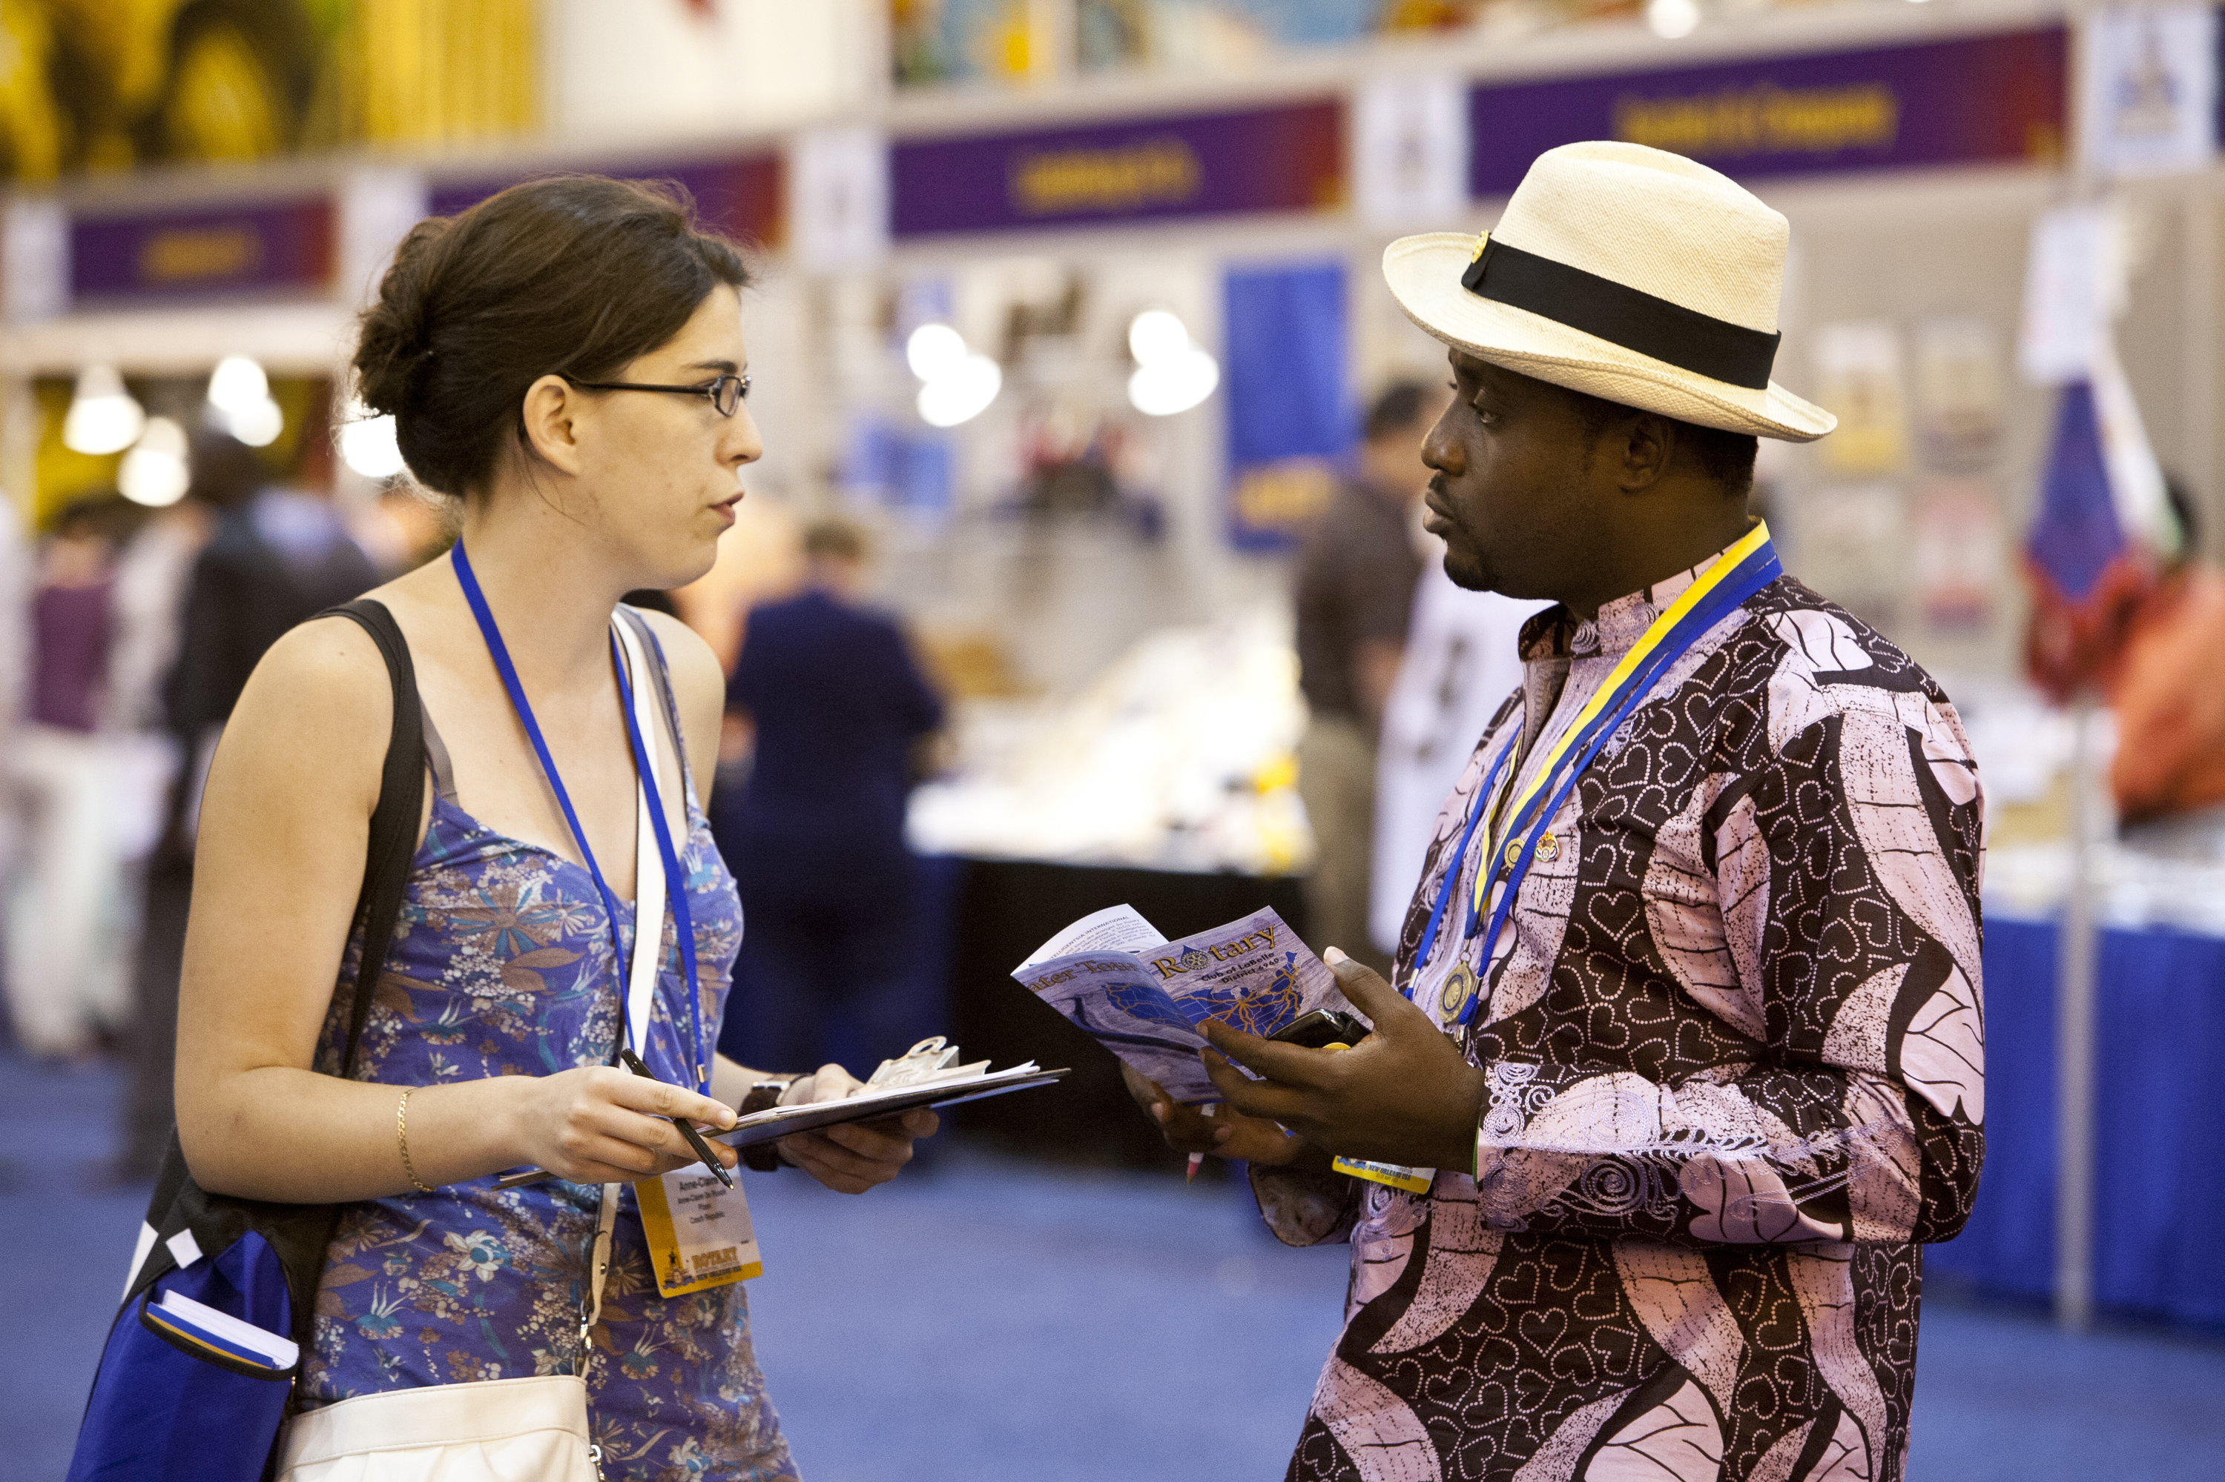
PARTNERS FOR DISTICT GRANTS
Other Rotary clubs
Clubs in other districts
Non-profits in your town
Churches
Youth groups
But stay involved and communicate.
YOU are in charge of the project!
Notes:
Speaking points:
With partners, Rotary clubs are able to implement projects they could not do on their own.
Partners can include other clubs, districts, or non-Rotary organizations.
For district grants, clubs can partner with clubs in the district or with other districts and their clubs.
Good communication helps keep all partners involved and allows them all to provide oversight.
Consider creating new partnerships and expanding Rotary networks.
Effective communication with project partners:
Establish how and how often you will be in contact to discuss the project.
Make sure everyone has correct information, such as email addresses for the club presidents and project committees for all partners.
Set up an alternate plan for communication, such as using a webinar, social media, or a teleconference.

Slide 12
Caution !
These “partners” can raise issues:
City or town
Government departments
School districts

Slide 13
PROJECT PLANNING Suggestions
Form a three-person grant committee
Assign roles
Make an implementation plan
Establish a budget
Have a contingency plan
Have a document retention plan
ONE PERSON projects can fail!
Notes:
Speaking points:
Rotarians must manage all projects that receive funding from The Rotary Foundation.
Suggest a committee of three Rotarians to manage the project.
Roles and responsibilities should be assigned to everyone on the committee.
Create a plan for managing funds and implementing the project.
Develop a budget that includes details and a timeline for the purchase and distribution of goods, training, and any other activities.
Consider your liability for the project, ensure that your club is protected, and have a contingency plan in case something goes wrong.
Set up a process for retaining documents related to the grant (see club MOU section 6) before funds are received.

Slide 14

CREATING A BUDGET
Realistic
Competitive bidding
Get real prices
Cost of materials
is rising!
Disclose conflicts of
interest PUT IN APPLICATION
Notes:
Speaking points:
A budget should be realistic and comprehensive to ensure adequate funding.
When choosing a supplier, Rotarians should use a competitive bidding process to ensure that they get the highest quality goods at the best prices.
Clubs should keep records of any submitted bids.
Clubs must disclose any potential or real conflicts of interest related to the budget.

Slide 15

SETTING GOALS
Measurable
Sustainable
Qualitative
Quantitative
Gather baseline data
Determine method of
measurement
Notes:
Speaking points:
A good place to start when defining a sustainable goal is to consider what change in behavior or knowledge you hope project participants will achieve.
Ensure that all project components directly support those goals.
Project goals should be measurable so you can quantify the impact of the project.
Goals should support sustainable activities that can continue after grant funds are spent.
Both qualitative (descriptive) and quantitative (numeric) goals should be included.
Start by gathering baseline data from your needs assessment. (For example, a hospital delivering 1,000 babies per year has an infant mortality rate of 15 percent and a maternal mortality rate of 8 percent.)
Then set concrete project goals. (For example, within three years, the infant mortality rate will be reduced to 8 percent, and the maternal mortality rate to 4 percent.)
Determine how and when you will measure your results. (For example, create an annual report using hospital statistics.)
Discussion questions:
What are some characteristics of a sustainable goal?
What sustainable goals have you seen set in projects?
Describe a project or aspects of a project that directly link to a measurable goal.

Slide 16
PROJECT EXAMPLES
Rise Against Hunger meal packaging
School supplies for needy children
Wheelchair lift at Camp Fairlee
Educational materials for literacy program
Musical instruments and lessons for under served youth
Grills in local park
Toilets in Cameroon
Notes:
Variety of projects: educational, health and literacy.
(Tanzania on next slide!)

Slide 17
LOCAL OR INTERNATIONAL
Cameroon? YES
In the district, state, region, U.S.
In a foreign country – district grant does NOT require a partner district or club
Application MUST be very thorough with identifying partner, financials, timeline, source of materials, member participation.
Notes:
Tanzania? YES, projects can be done outside of the U.S. Unlike a global grant which requires a partnering district or club, district grants DO NOT require a partner. Middletown Odessa is the primary club on a multiple club grant that drilled four wells in Tanzania last Fall with Kenny Woods doing the drilling. Project can take place anywhere here or abroad.

Slide 18
PROJECT CHAIRS WITHIN YOUR CLUB
PLEASE NOTE:
Primary contact on application should be member actually LEADING THE PROJECT.
Primary contact should have attended the GMS today.
Primary contact should complete and submit the final report.

Slide 19

PROJECTS NOT PERMITTED
Not approved for District Grants:
Fundraising
  Purchase of land or buildings; rent
  Establishment of trust or Foundation
  Administrative $$$ to
  another organization
  See Terms and Agreements
  for more No-No’s
Notes:
See the Terms and Agreements

Slide 20
QUALIFICATIONS
Notes:
How do you know if your club qualifies for a district grant?

Slide 21
All are eligible…
All clubs may apply for and will be deemed eligible to receive District Grant funds as the primary club applicant!
Serious consideration is given to clubs who’s per capita giving to the Annual Programs Fund at the end of the prior Rotary year in which the grant application is submitted, or as of June 1 of the current year the grant application is submitted, meets or exceeds $100.
Notes:
Committee will consider prior year’s giving to the Annual fund as well as the current year to June 1. REPEAT: ALL clubs eligible to apply for a district grant.
Example: If you submit a grant application in June of this year, 2015, the grants committee will look at your club’s giving to the Annual fund at the end of June 2104 (the year prior!) as well as the current year as of June 1, 2015. If your club reached $100 per capita at either point, your club’s grant application will be given serious consideration over a club that did not reach $100 per capita at either point.

Slide 22
QUALIFICATION REQUIREMENTS
TWO members must attend a Grants Management Seminar
Complete the Memorandum of Understanding (MOU), sign AND SUBMIT WITH APPLICATION
Have no outstanding dues / invoices / reports with RI or District 7630
Notes:
Speaking points:
TWO members must attend the GMS. And sign the attendance sheet.
The MOU must be signed by you and CURRENT president. Must be submitted with the grant application

Slide 23
DDF Committee reviews all applications…
with consideration given to:
Multiple Club projects over single club projects
Amount given to Annual Fund in previous year or up to June 1 of current year
SEVEN areas of focus by RI
Worthy investment of district dollars
Completion of previous reports
Attendance at GMS
Competitive bidding / supporting documentation/complete and legible application

Slide 24
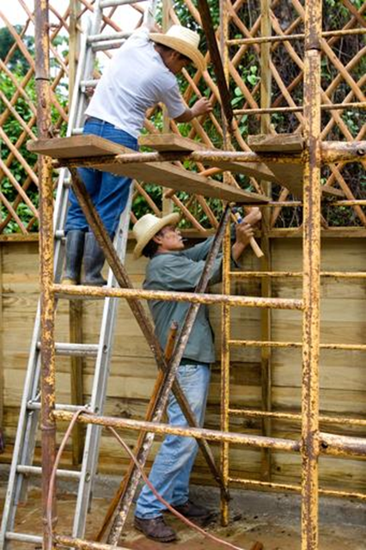
TERMS OF QUALIFICATION
Valid for one year
Club responsible for grant funds – cannot give to another organization
to implement the project
Disclose conflicts of interest
Cooperate with all audits
Use grant funds properly
Notes:
Speaking points:
Once a club successfully completes the qualification requirements, the club will receive qualified status for one Rotary year.
All club members understand that the club as an entity is responsible for the use of grant funds.
The club must disclose any conflicts of interest in compliance with the Conflict of Interest Policy as outlined in The Rotary Foundation Code of Policies.
The club must cooperate with any site visits, reviews, and audits.
Misuse of grant funds could result in suspension of the club’s qualification status.
Failure to implement the club MOU could result in a loss of qualified status.
Discussion questions:
How will you ensure that your club or district will comply with the MOU requirements?
If it appears funds have been misused, how will your club handle the situation?

Slide 25
MAINTAINING QUALIFICATION
Follow terms of club MOU
Appoint a club member or committee to manage club qualification
Fully implement stewardship practices to prevent misuse of funds
Notes:
Speaking points:
In order to maintain qualified status for one year, clubs must:
Abide by the terms of the MOU, the grant terms and conditions, and the Rotary International and Rotary Foundation codes of policies.
Appoint one or more club members to manage club qualification.

Slide 26
DISTRIBUTION of approximately $60,000
Committee may or may not fund 100% of requested amount
Committee may or may not provide any funding to a project
REIMBURSEMENT to club AFTER project completed and final reports are satisfied
Notes:
This is a reimbursement process. Clubs must front the entire cost of the project at time of implementation. Providing the Final report is approved and all financials are approved, the Foundation treasurer will begin the process to issue the club a check in the amount of the grant.
As soon as the project is completed, and all paperwork and copies of cancelled checks have been received, submit your Final Report. You do not have to wait until June1, 2016.

Slide 27
APPLYING FOR AND IMPLEMENTING A GRANT

Slide 28
HOW TO START
Two club members attend a GMS
Read and understand District 7630 Terms and Agreement Policy for District Grants
Identify project and potential partners
Get approval from club members
Notes:
District 7630 Terms and agreement included in your package, along with a grant application for 2015-16 district grants.
Make sure your club members have buy-in with project.
Include MOU. Submit BEFORE June 1, 2015 to Robin Broomall at address or email on application.

Slide 29
GRANTS TIMELINE
Submit application and MOU to Grants sub-committee by midnight June 1, 2024.
District Approval/Rejection notice by June 30, 2024
DO NOT BEGIN project until RI approval and notified to begin (Hopefully in July)
Mid Year Status report due to District Grant Chair by January 1st
Complete project and submit Final Report by midnight June 1, 2025.
Notes:
Application due on or before June 1 of this year.
Committee will review and give preliminary approval or notify you of rejection along with amount of grant awarded.
You can begin planning the project or do fundraising, but DO NOT actually begin the project until told to do so. RI must approve first.
Project must be completed and final report submitted to The Gants Committee by June 1, 2016. Final grant report will be available on DaCdb.

Slide 30
RECORD KEEPING
Read the Final Report FIRST!
Final report needs:
All documentation for project
Copies of press releases, pictures, invoices, copies or facsimiles of cancelled checks, competitive bidding, disclosure of conflict of interest and more…
Keep all records for FIVE years.
Notes:
Briefly the final report will want copies of all documentations with the project, including quotes, press releases, copies of invoices and MOST IMPORTANTLY copies or bank facsimiles of your cancelled checks.
You are required to keep all records for five years for possible auditing purposes.

Slide 31
PAYMENTS BY PRIMARY CLUB
Primary club must pay vendors directly
Primary club must pay vendors directly
Cannot reimburse another organization.
Notes:
At District Conference in Baltimore, 9 a.m. Friday May 1
Invite Foundation chair, grants chair, other club officers, anyone who will be involved with your grant project.
Reminder: TWO members of the primary club must attend a GMS this year.

Slide 32
PAYMENTS BY PRIMARY CLUB
IF a club member does the purchasing, they CAN be reimbursed by the club
Must show the complete paper trail
invoices or receipts
credit card payment, statement,
cancelled check, bank statement
club check to member, etc.

Slide 36
FINAL REPORT DUE ON/BEFORE JUNE 1, 2025
When your project is done, assemble all documents, complete Final Report and SUBMIT!
DO NOT wait until June 1!
Email report and documents to the District Grants Chair!

Slide 37
FORMS NEEDED
Application Form
FAQ
Terms and Agreements
Memo of Understanding (MOU)
Timeline/Checklist
Final Report Form
All forms will be in DACdb:
District Files, Secure Files, 24-25 District Grants

Slide 38
Questions?

Slide 39
Upon completion of today’s GMS:
Email within 30 minutes:
Your name and club name
Answer these two questions:
When are mid-year reports due to the District Grant Chair?
When can you begin your district grant project?
mmudronrotary@gmail.com

